Slide 1
Probability review
Year 9 2019

Slide 2
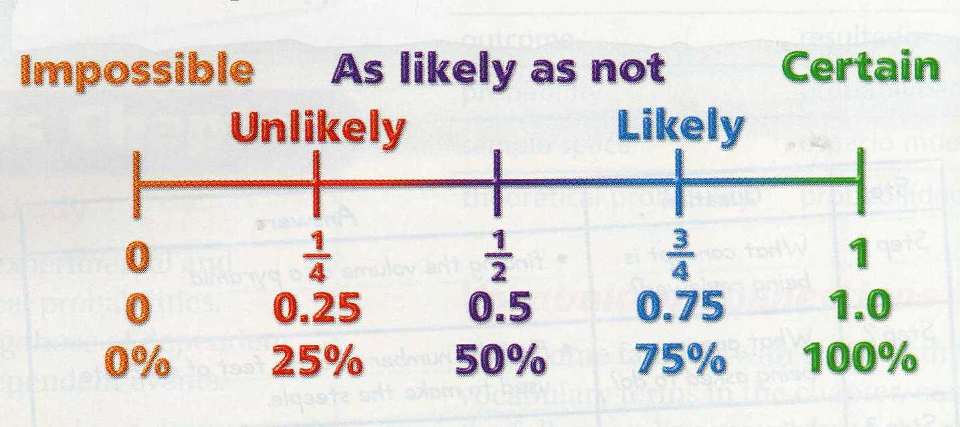
24
7
30
Topic: Probability
Date:
EQ – What have we learnt about probability so far?
Probability: is the likelihood that an event will occur.
Probability can be written as a fraction or decimal.
What is probability?
_______________
_______________
_______________

Slide 3
24
7
30
Topic: Probability
Date:
EQ – What have we learnt about probability so far?
Probability is always between 0 and 1.
Probability = 0 means that the event will NEVER happen.
Example: The probability that the Perth Wildcats will win the AFL Grand Final in 2019.
Probability = 1 means the event will ALWAYS happen.
Example: The probability that Christmas will be on December 25th next year.
What is probability?

Slide 4


Slide 5
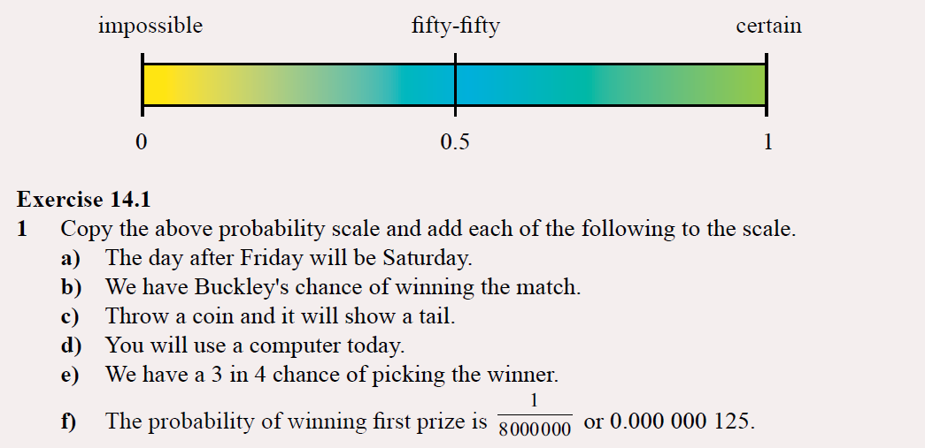
Practice
Notes:
Guide students through the question.
Option 2: Dot plots handout (Scaffolded for kids who may need extra help)

Slide 6
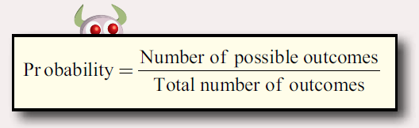
24
7
30
Topic: Probability
Date:
EQ – What have we learnt about probability so far?
How to calculate probability?

Slide 7
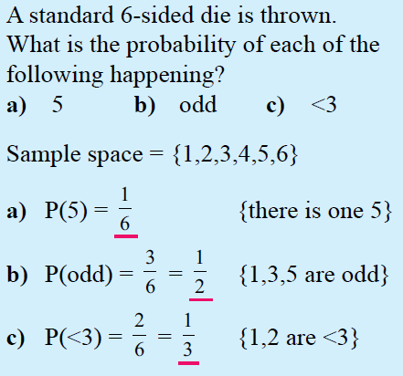
24
7
30
Topic: Probability
Date:
EQ – What have we learnt about probability so far?
Sample space: A list of all the possible outcomes.
{ } - These brackets we use when listing sample space
< 3 means less than 3, so 1OR 2
How to calculate probability?

Slide 8
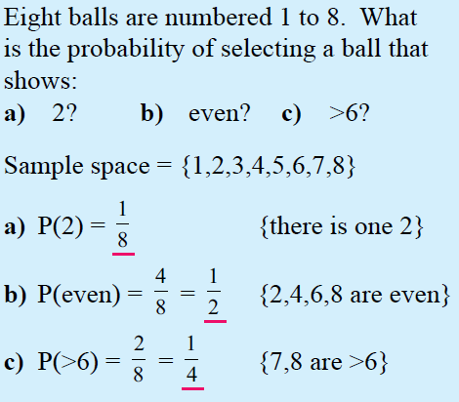
24
7
30
Topic: Probability
Date:
EQ – What have we learnt about probability so far?
> 6 means any number larger than 6, in our sample space.
How to calculate probability?

Slide 9
24
7
30
Topic: Probability
Date:
EQ – What have we learnt about probability so far?
Complement: means an event not happening.
Ex. The complement of it raining, is it doesn’t rain.
What is complementary Probability?
The complement of event “A” is “not event A” - We write this as A’
Not A = A’
The sum of the probability of an event and its complete is 1
P(A) + P(A’) = 1.
Example, There is a 20% chance we will get ice-cream. There is then an 80% we wont. 20% + 80% = 100%, 100% = 1
Therefore P(A’) = 1 - P(A)

Slide 10
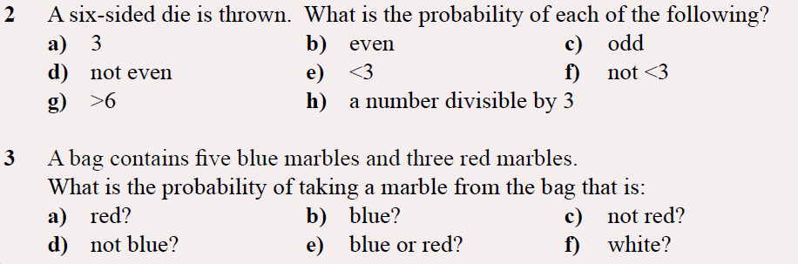
Task: Hint: List the sample space of all available outcomes first
Notes:
Guide students through the question.
Option 2: Dot plots handout (Scaffolded for kids who may need extra help)

